Slide 1




QuizUp – a Quiz App
SUBMITTED BY – ANUSHKA RAWAT
2018703
Under the mentorship of – Ms. Tanusha Mittal
Assistant professor

Slide 2
Introduction
In today’s world, smartphones have changed our lives and have become an indispensable part of our lives. There is an increasing need of developing mobile applications that cater to all the needs of the users. Hence there are a variety of apps available in the play store nowadays.
In this project, a basic Quiz application has been developed with the help of Android Studio using Kotlin as the programming language.
This application aims to test the general knowledge of the user and promote general awareness among the mass. This project offers users to test themselves through their mobile only with a simple and attractive user interface(UI).

Slide 3
Methodology
Applications and Technology Used:
Android Studio: Android Studio is the official Integrated Development Environment (IDE) for designing, coding, debugging, and executing applications for Google’s Smartphone operating system, Android.
Java Development Kit (JDK): Since Android applications require Java or Kotlin programming for their backend programming; it needs an environment to support its functions, executions, and syntax. The Java Development Kit (JDK) is essential for Kotlin programming in Android Studio. Kotlin is fully interoperable with Java, which means it can utilize Java libraries, frameworks, and tools. Since Kotlin compiles down to Java bytecode, it requires the JDK to compile Kotlin code and run Kotlin applications.
Xml: The front-end design of the application involves xml statements for the Relative layouts, Radio buttons, Radio Group, buttons, text boxes, and text views.

Slide 4
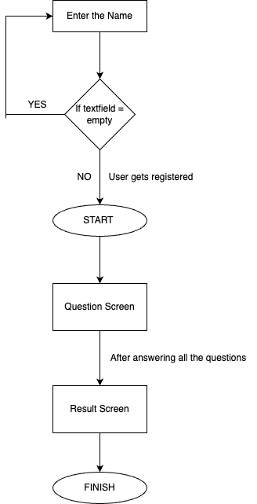
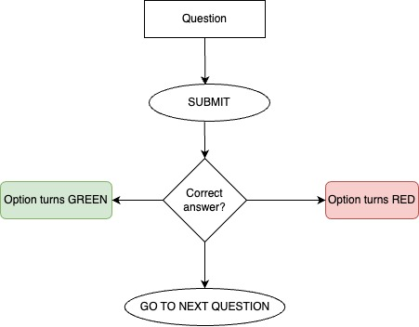

Slide 5
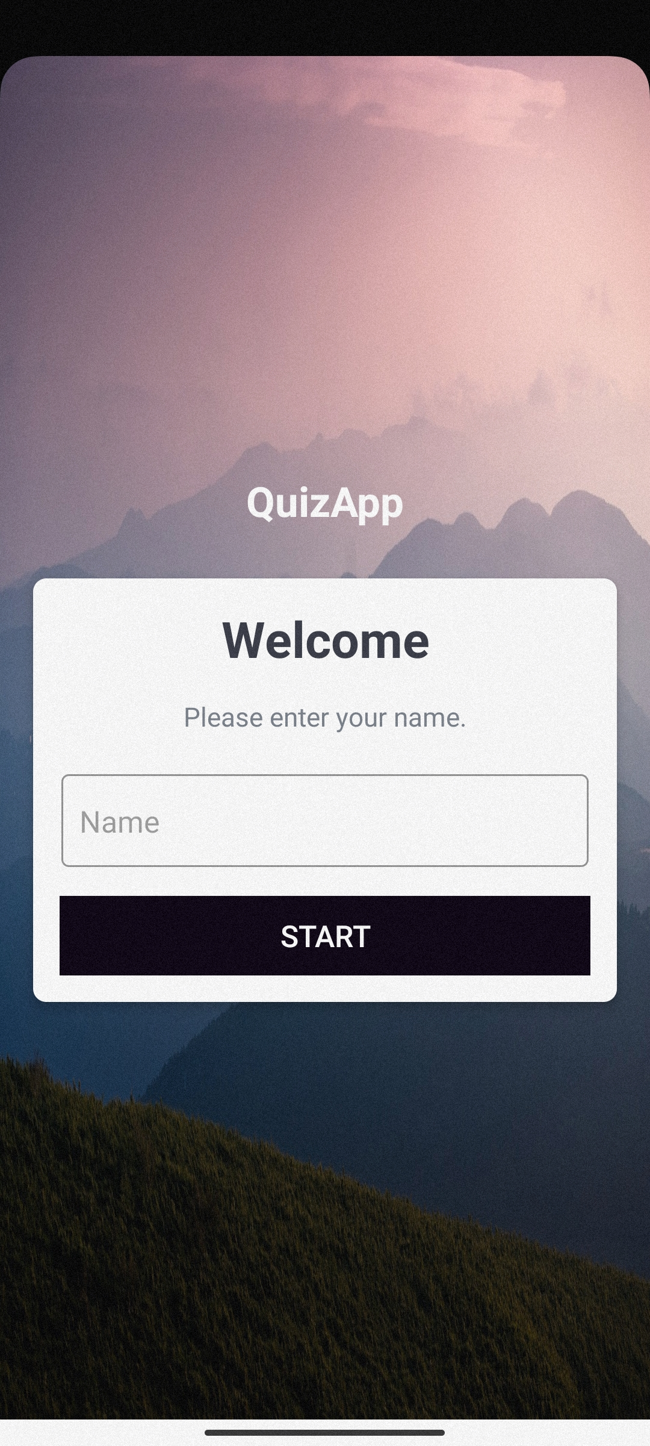
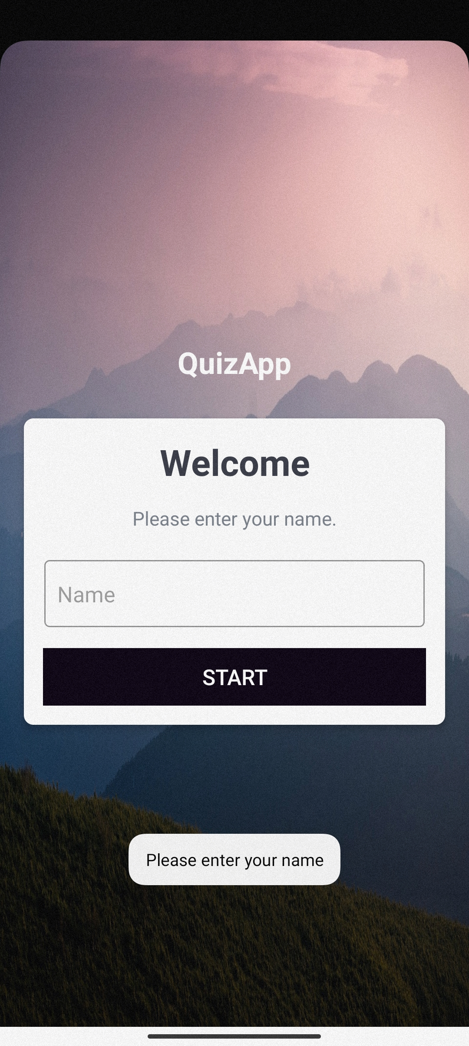
~ The Welcome Page ~
Result

Slide 6
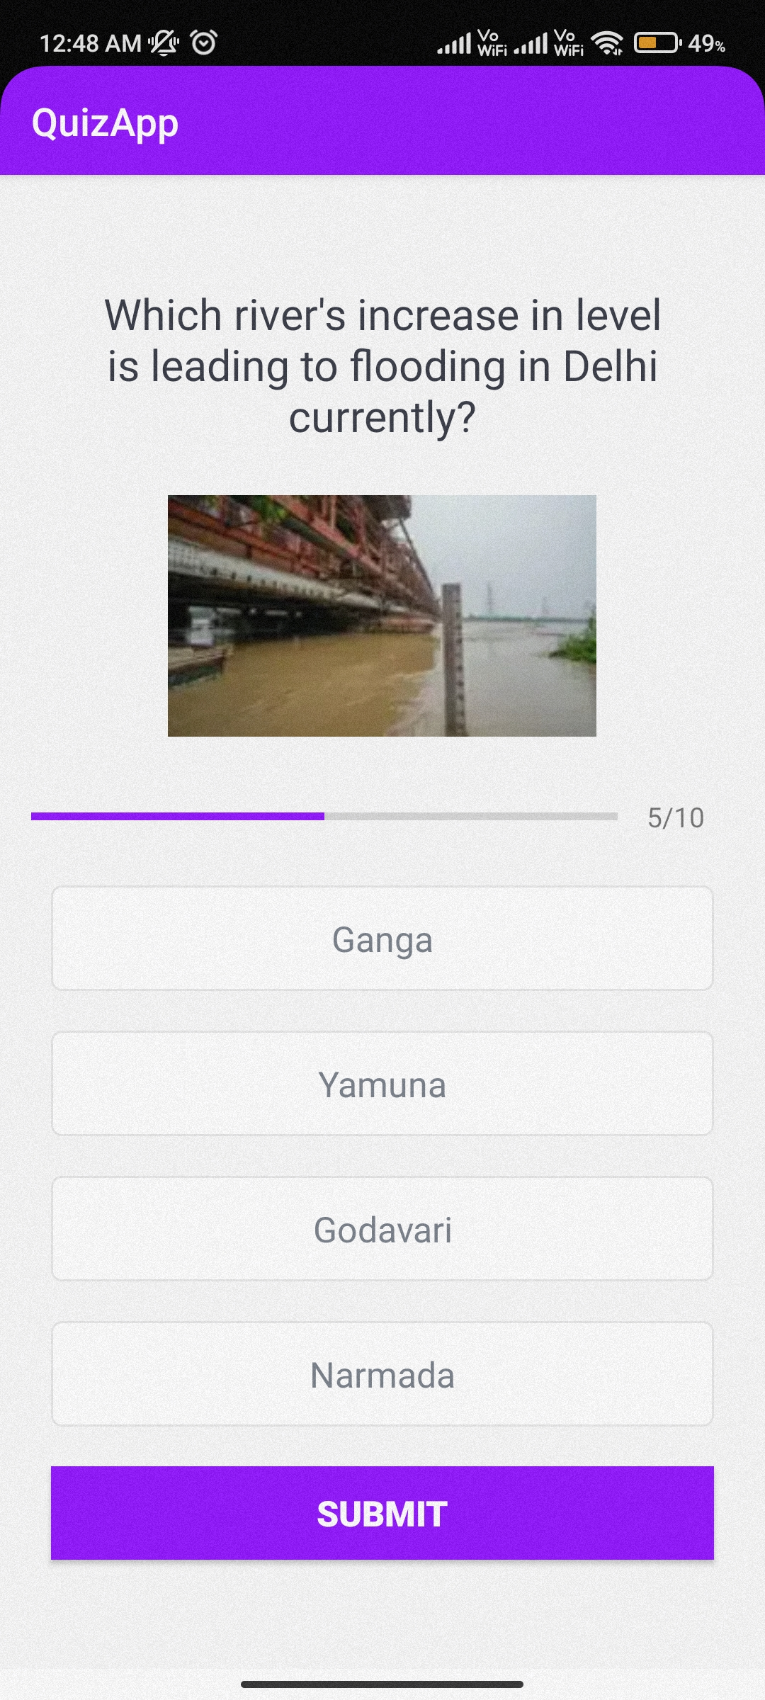
~ Questions Activity ~

Slide 7
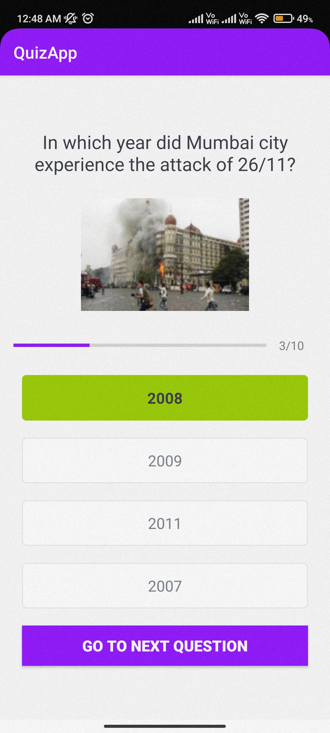
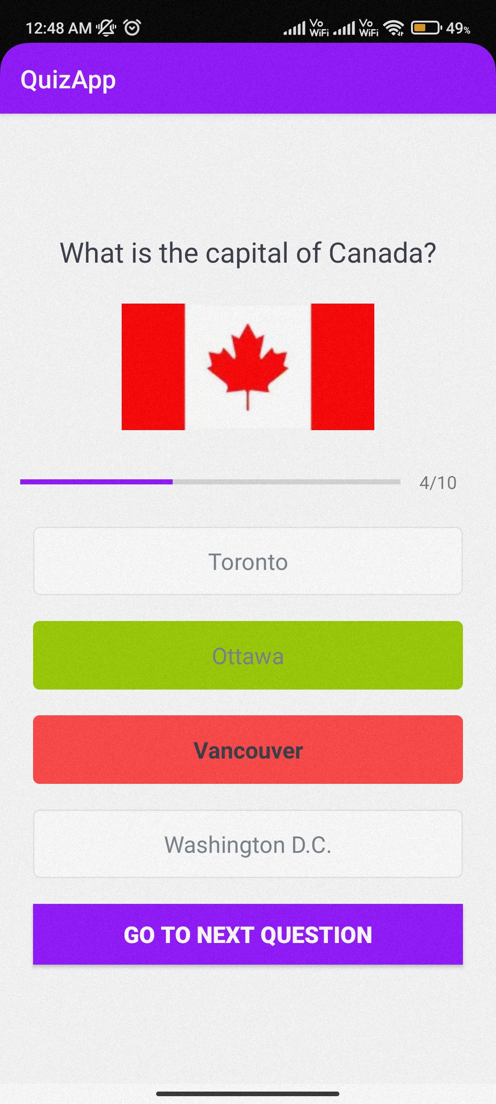
~ Questions Activity ~

Slide 8
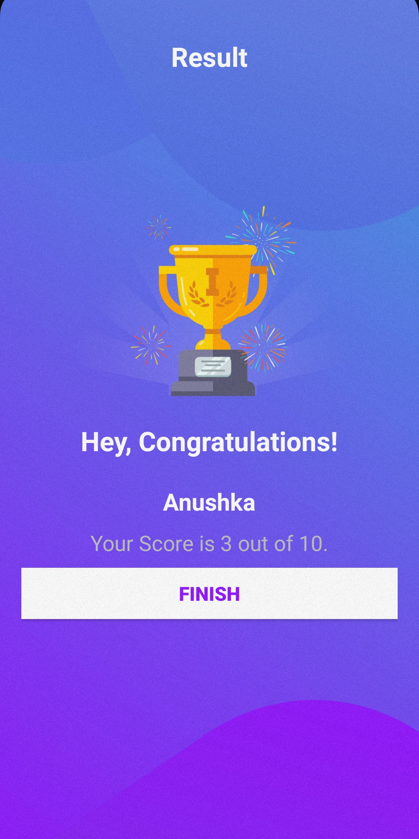
~ The Result Page ~

Slide 9
Conclusion
The era of mobile technology has opened the windows to Android apps. Many users prefer to access information, pass time, test their knowledge, and learn new things through mobile applications in contrast to conventional websites.
To cater to the increasing demand for mobile applications, in this project, a Quiz application has been developed with the help of Android Studio using Kotlin as the programming language.

Slide 10
Future Work
In this project, a basic quiz application has been developed. It can be made advanced by increasing the number and diversity of questions, distributing the questions topic-wise, and asking the users the topic they want to be tested on.
We can also add a function that randomizes the questions asked to give the user a new experience every time. Some more features like a timer, leaderboard, and inviting friends can be added to the application in the future.
We can also save the answers entered by the user for their future reference by connecting the application with a database to store the necessary information of the user.

Slide 11
Thank You!

